Slide 1
Migrating Legacy Public Folders to Modern Public Folders and Office 365 Groups
Thomas Stensitzki, Granikos GmbH & Co. KG
MVP | MCSM | MCT
@stensitzki

Slide 3


Thomas Stensitzki
Enterprise Consultant Granikos GmbH & Co. KG MVP | MCSM | MCT @stensitzki thomas.stensitzki@granikos.eu http://JustCantGetEnough.Granikos.eu http://blog.Granikos.eu

Slide 4
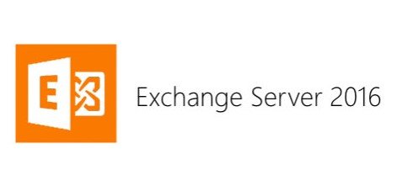


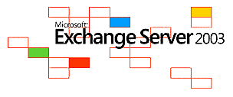


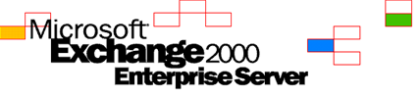
Exchange Server Questionnaire

Slide 5
The Public Folder Dilemma

Slide 6
Legacy Public Folders
Introduced in Exchange Server 4.0 in 1996
Provided business collaboration functions like email, calendars, to-do lists, contacts, discussion forums, file sharing, and even some sort of instant messaging
Access Control Lists to make public folders private
Available in all Exchange Server versions up to Exchange Server 2010
Dedicated replication engine with multi-master functionality
Exchange Management Console for full management capabilities
Outlook for Windows is the primary client to access public folders

Slide 7
Modern Public Folders
Introduced with Exchange Server 2013 in 2012
Major changes in how public folder data is stored a replicated
No public folder coexistence with legacy public folders
No technical change in managing access to public folder content
Available in all modern Exchange Server versions*
No multi-master replication
PowerShell as primary tool for managing public folders
Outlook for Windows is still the primary client to access public folders
* Some restrictions apply regarding supported public folder sizes and limits

Slide 8
Exchange Server 2010
Last legacy Exchange Server version supporting legacy public folders
Coexistence with on-premises Exchange Server 2013 / 2016
→ Modern mailbox user can access Legacy Public Folders
Hybrid-Coexistence with Exchange Online
→ Exchange Online mailbox user can access on-premises legacy public folders
Cannot coexist with Exchange Server 2019
End of Support
January 14th 2020

Slide 9
What are your options?
Source Public Folder Version | Target Public Folder Version | Remarks
Exchange Server 2007 | Exchange Server 2010 Exchange Server 2013 | Exchange Server 2007 is End-of-Life and must be replaced Migrating to Exchange 2010 extends legacy public folder lifecycle
Exchange Server 2010 | Exchange Server 2013 Exchange Server 2016 Exchange Online | Migration to either on-premises Exchange Server or Exchange Online possible
Exchange Server 2013 | Exchange Server 2016 Exchange Server 2019 Exchange Online | Modern Public Folders can easily be moved on-premises or migrated to Exchange Online
Exchange Server 2016 | Exchange Server 2019 Exchange Online | Modern Public Folders can easily be moved on-premises or migrated to Exchange Online
Exchange Server 2019 | Exchange Online | Modern Public Folders can easily be migrated to Exchange Online

Slide 10
Migration to Modern Public Folders

Slide 11
Prepare your Legacy Public Folders (1)
Upgrade to Exchange Server 2010 UR 8 or newer (UR 27 latest)
Check public folder replication of public folder databases first
Cleanup public folder access control lists
Cleanup orphaned email activated public folder objects in Active Directory
→ Microsoft Exchange System Objects (MESO) container
Remove private attribute on all public folder objects
Reduce the number of public folders in the hierarchy
Challenge the use of email enabled public folders
Notes:
https://www.microsoft.com/en-us/download/details.aspx?id=58196
https://docs.microsoft.com/de-de/exchange/new-features/build-numbers-and-release-dates?view=exchserver-2019

Slide 12
Prepare your Legacy Public Folders (2)
Update public folder names to exclude ‘\’, ‘/’ and leading/trailing spaces
Have OutlookAnywhere published to the Internet when migrating to Exchange Online
Have AutoDiscover published correctly internally and externally
Notes:
https://www.microsoft.com/en-us/download/details.aspx?id=57824

Slide 13
Public Folder Migration Steps
Download an prepare the migration CSV Scripts
Cleanup any existing Public Folder migrations, if any exist
Prepare the modern Public Folder infrastructure
Create and start the migration batch
Monitor the migration batch and remove all issues
Finalize the migration batch → downtime for Public Folder access
Test access to modern Public Folders
Switch access to modern Public Folder → Point of no return
https://go.granikos.eu/MSPFBatchMigration
Notes:
https://www.microsoft.com/en-us/download/details.aspx?id=57824

Slide 14
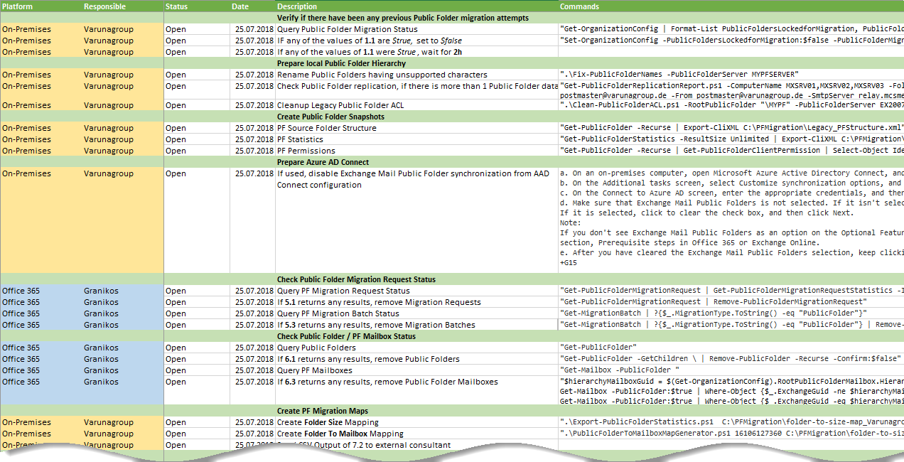
Public Folder Migration Action Plan
https://go.granikos.eu/PFMigActionPlan
Notes:
https://go.granikos.eu/PFMigActionPlan

Slide 15
Migration to Exchange On-Premises
Exchange Organization
Exchange 2010 Multi-Role Server
Public Folders
Modern Public Folders
Exchange 2016 Mailbox Server

Slide 16
Migration to Exchange Online
Exchange Organization
Exchange 2010 Multi-Role Server
Perimeter Network
Mailboxes
Migration Endpoint Config Public Folders
OutlookAnywhere
Public Folders
Modern Public Folders
Migration Endpoint Config Mailbox Moves
Exchange Webservice
Modern Mailboxes
Exchange 2016 Coexistence Server

Slide 17
Public Folders in Office 365 Groups and Microsoft Teams

Slide 18
Migration Constraints (1)
You can only migrate public folders of type mail or calendar
Create Office 365 Groups before migration
Migration does not support the migration of permissions and roles
→ Users are designated as either members or owners
Copies only email messages and calendar items
→ No rules and permissions
Office 365 Groups comes with a 50GB mailbox
Sum of public folder data must be less than 50GB
Recommend migrating public folders no bigger than 25GB in total size

Slide 19
Migration Constraints (2)
Not an "all or nothing" migration
Pick and choose specific public folders to migrate
Sub-folders are not automatically migrated – explicitly included in migration batch
Maximum of 2 public folders per target Office 365 Group One of type email, one of type calendar
Public folders are not affected by this migration
→ Once the migrated public folders are locked-down for read-only, users will be forced to use Office 365 Groups instead of public folders
Use a single migration batch to migrate all selected public folder data
→ Exchange allows only one public folder migration batch at a time

Slide 20
Migration Steps
Get the scripts
Prepare for the migration
List of public folders mapping to Office 365 Groups
Rename public folders with backslash ‘\’ prior to migration
Ensure that PAW is enabled in your Exchange Online tenant
Create CSV file
Start the migration request
Add members to Office 365 groups from public folders
Lock down the public folders (public folder downtime required)
Finalize the public folder to Office 365 Groups migration
Notes:
PAW = Protocol Agnostic Workflow, https://blogs.technet.microsoft.com/exchange/2017/12/01/paw-your-way-into-office-365-migrations/

Slide 21
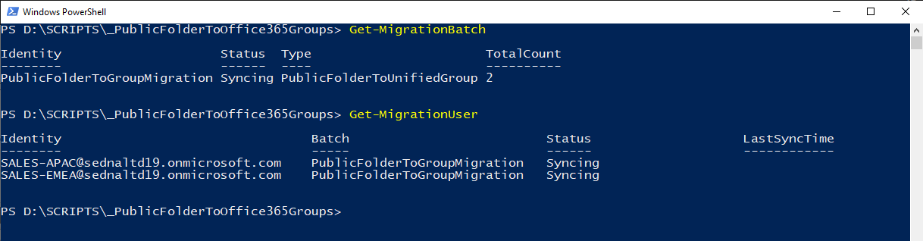
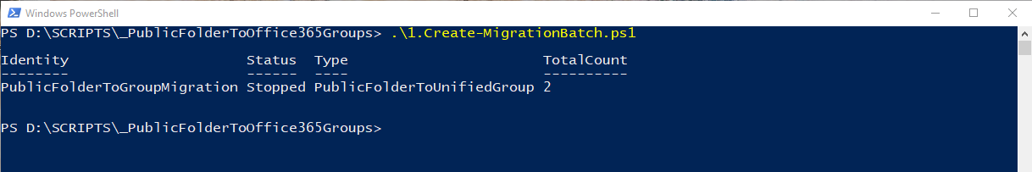
Create and start migration batch

Slide 22
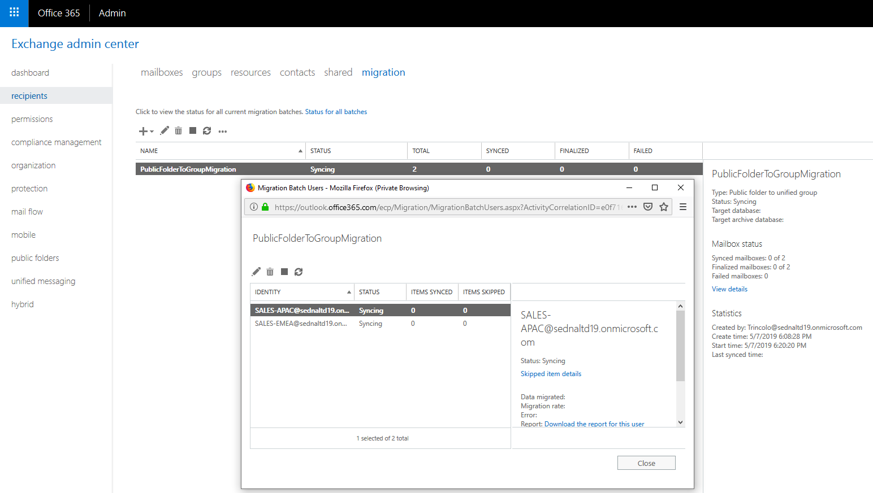

Slide 23
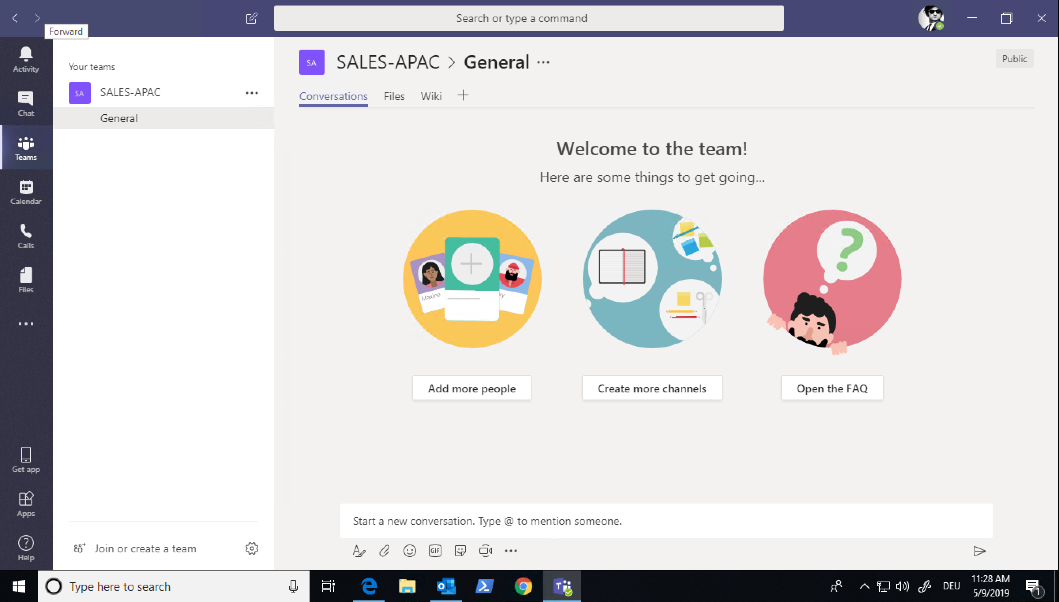
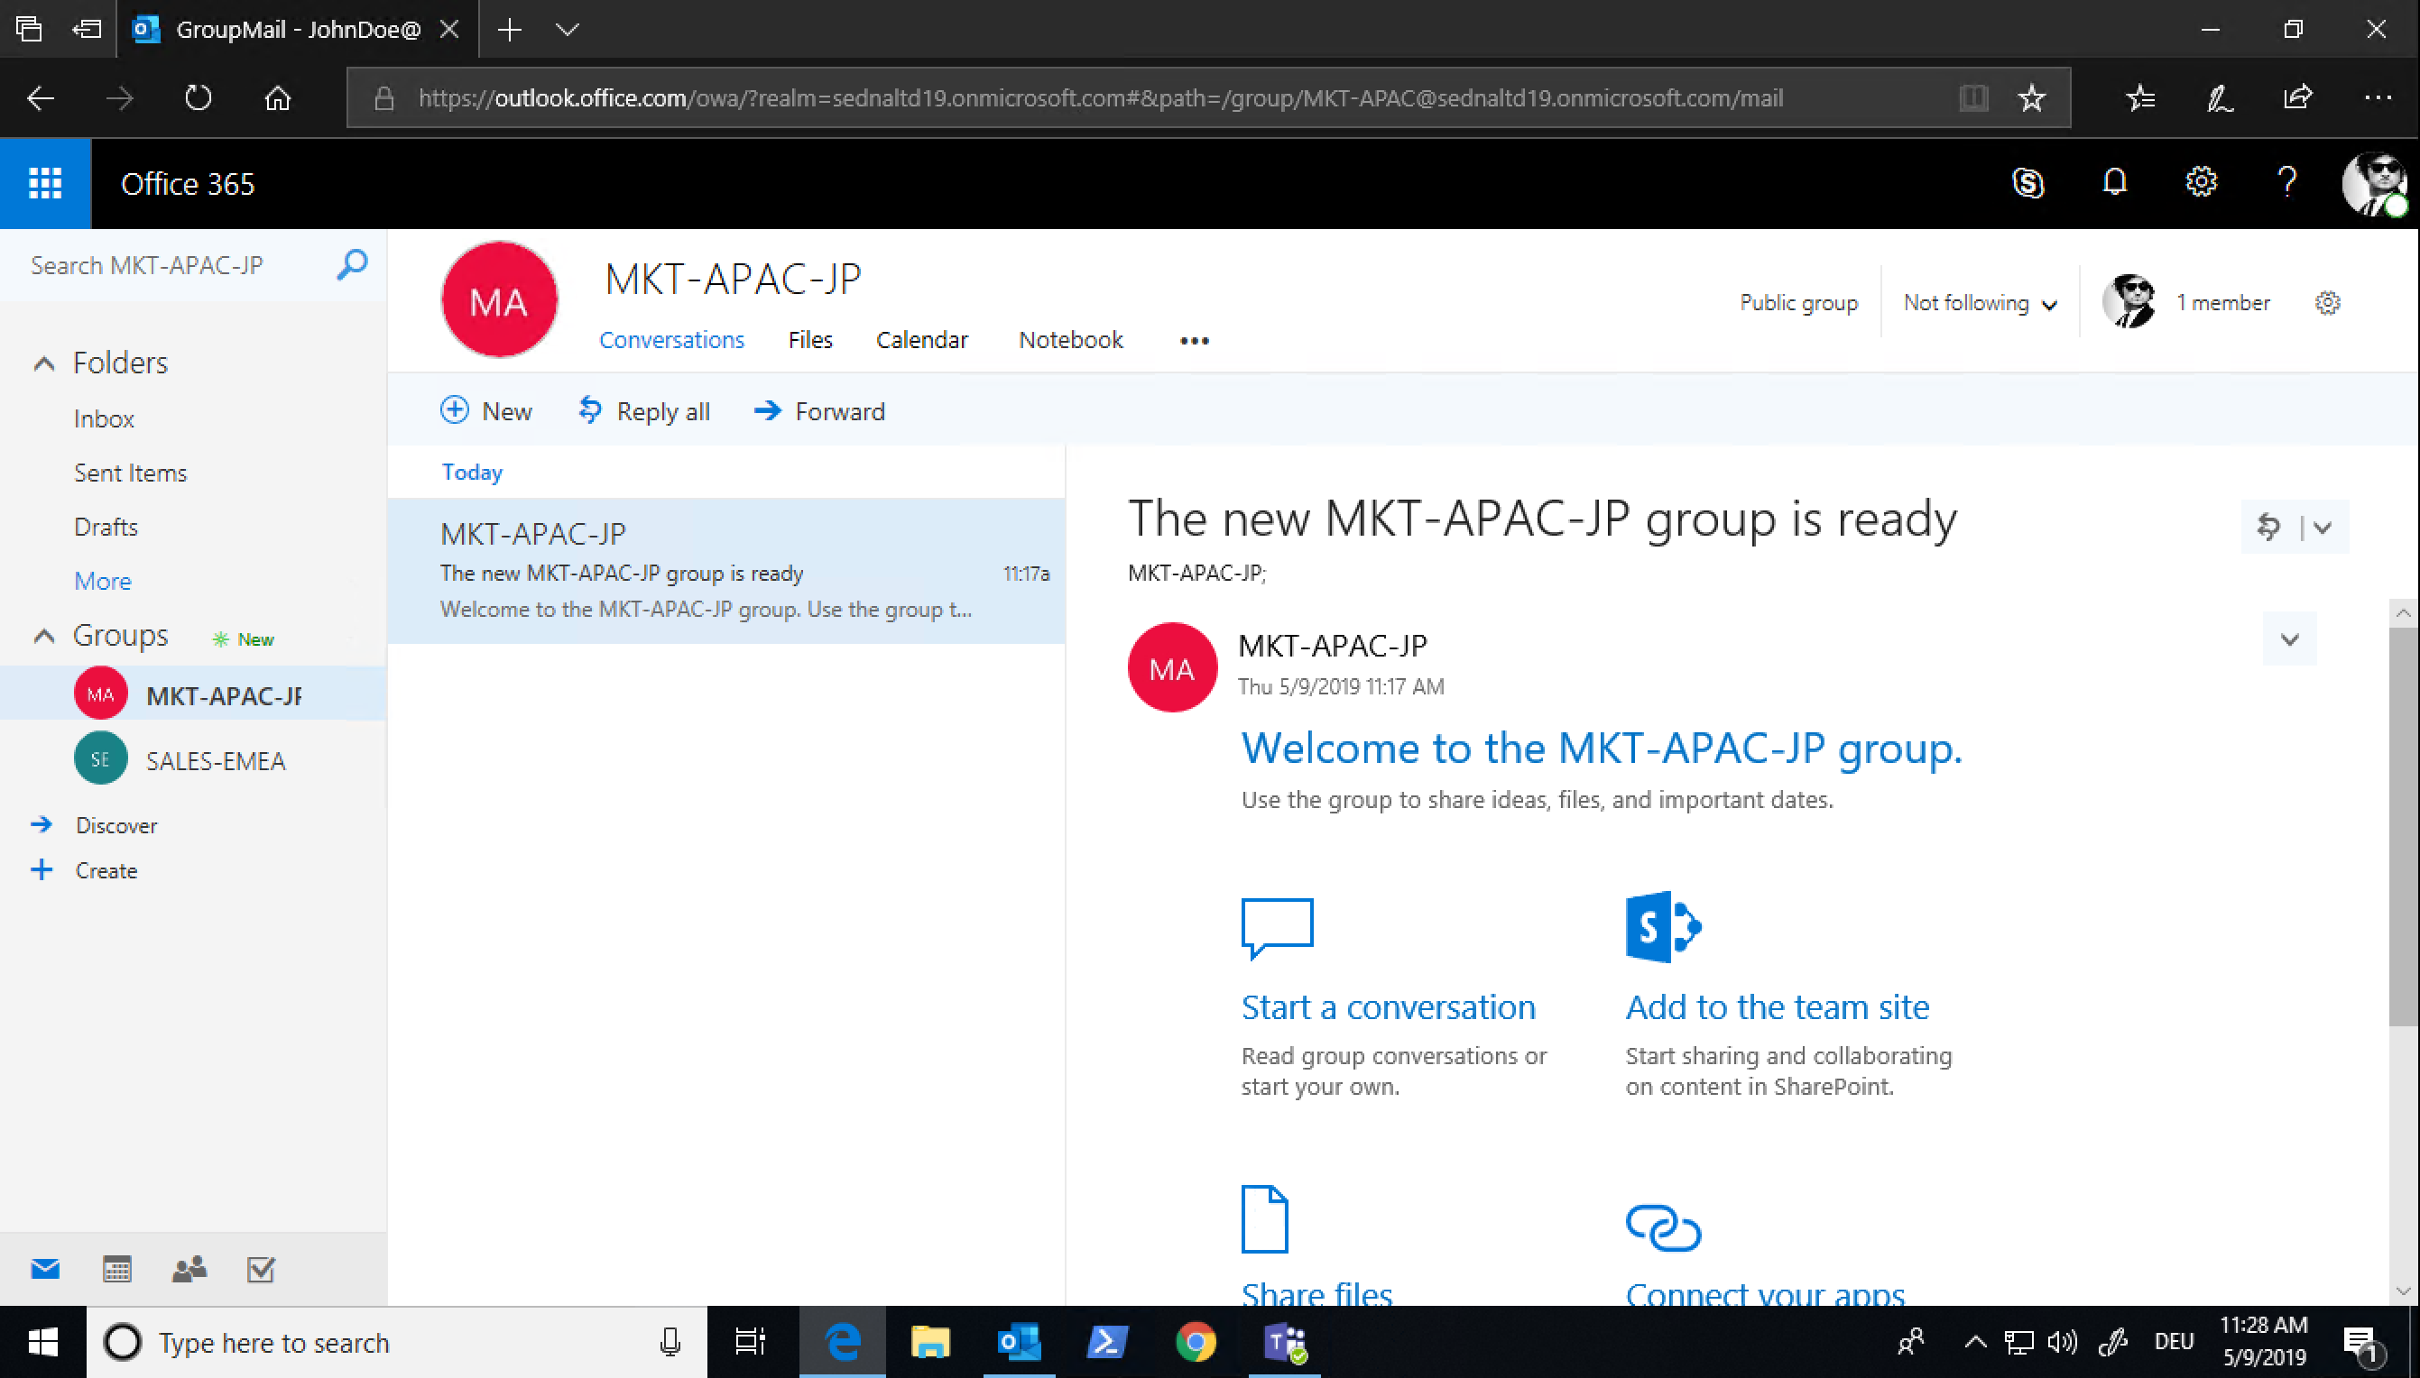

Slide 24
Visibility of a Team Mailbox
Teams enabled mailbox of an Office 365 Groups is hidden from client access by default
“unhide” the Office 365 Group mailbox using Exchange Online PowerShell
Set-UnifiedGroup -Identity O365Group@Tenant.onmicrosoft.com -HiddenFromExchangeClientsEnabled:$False

Slide 25
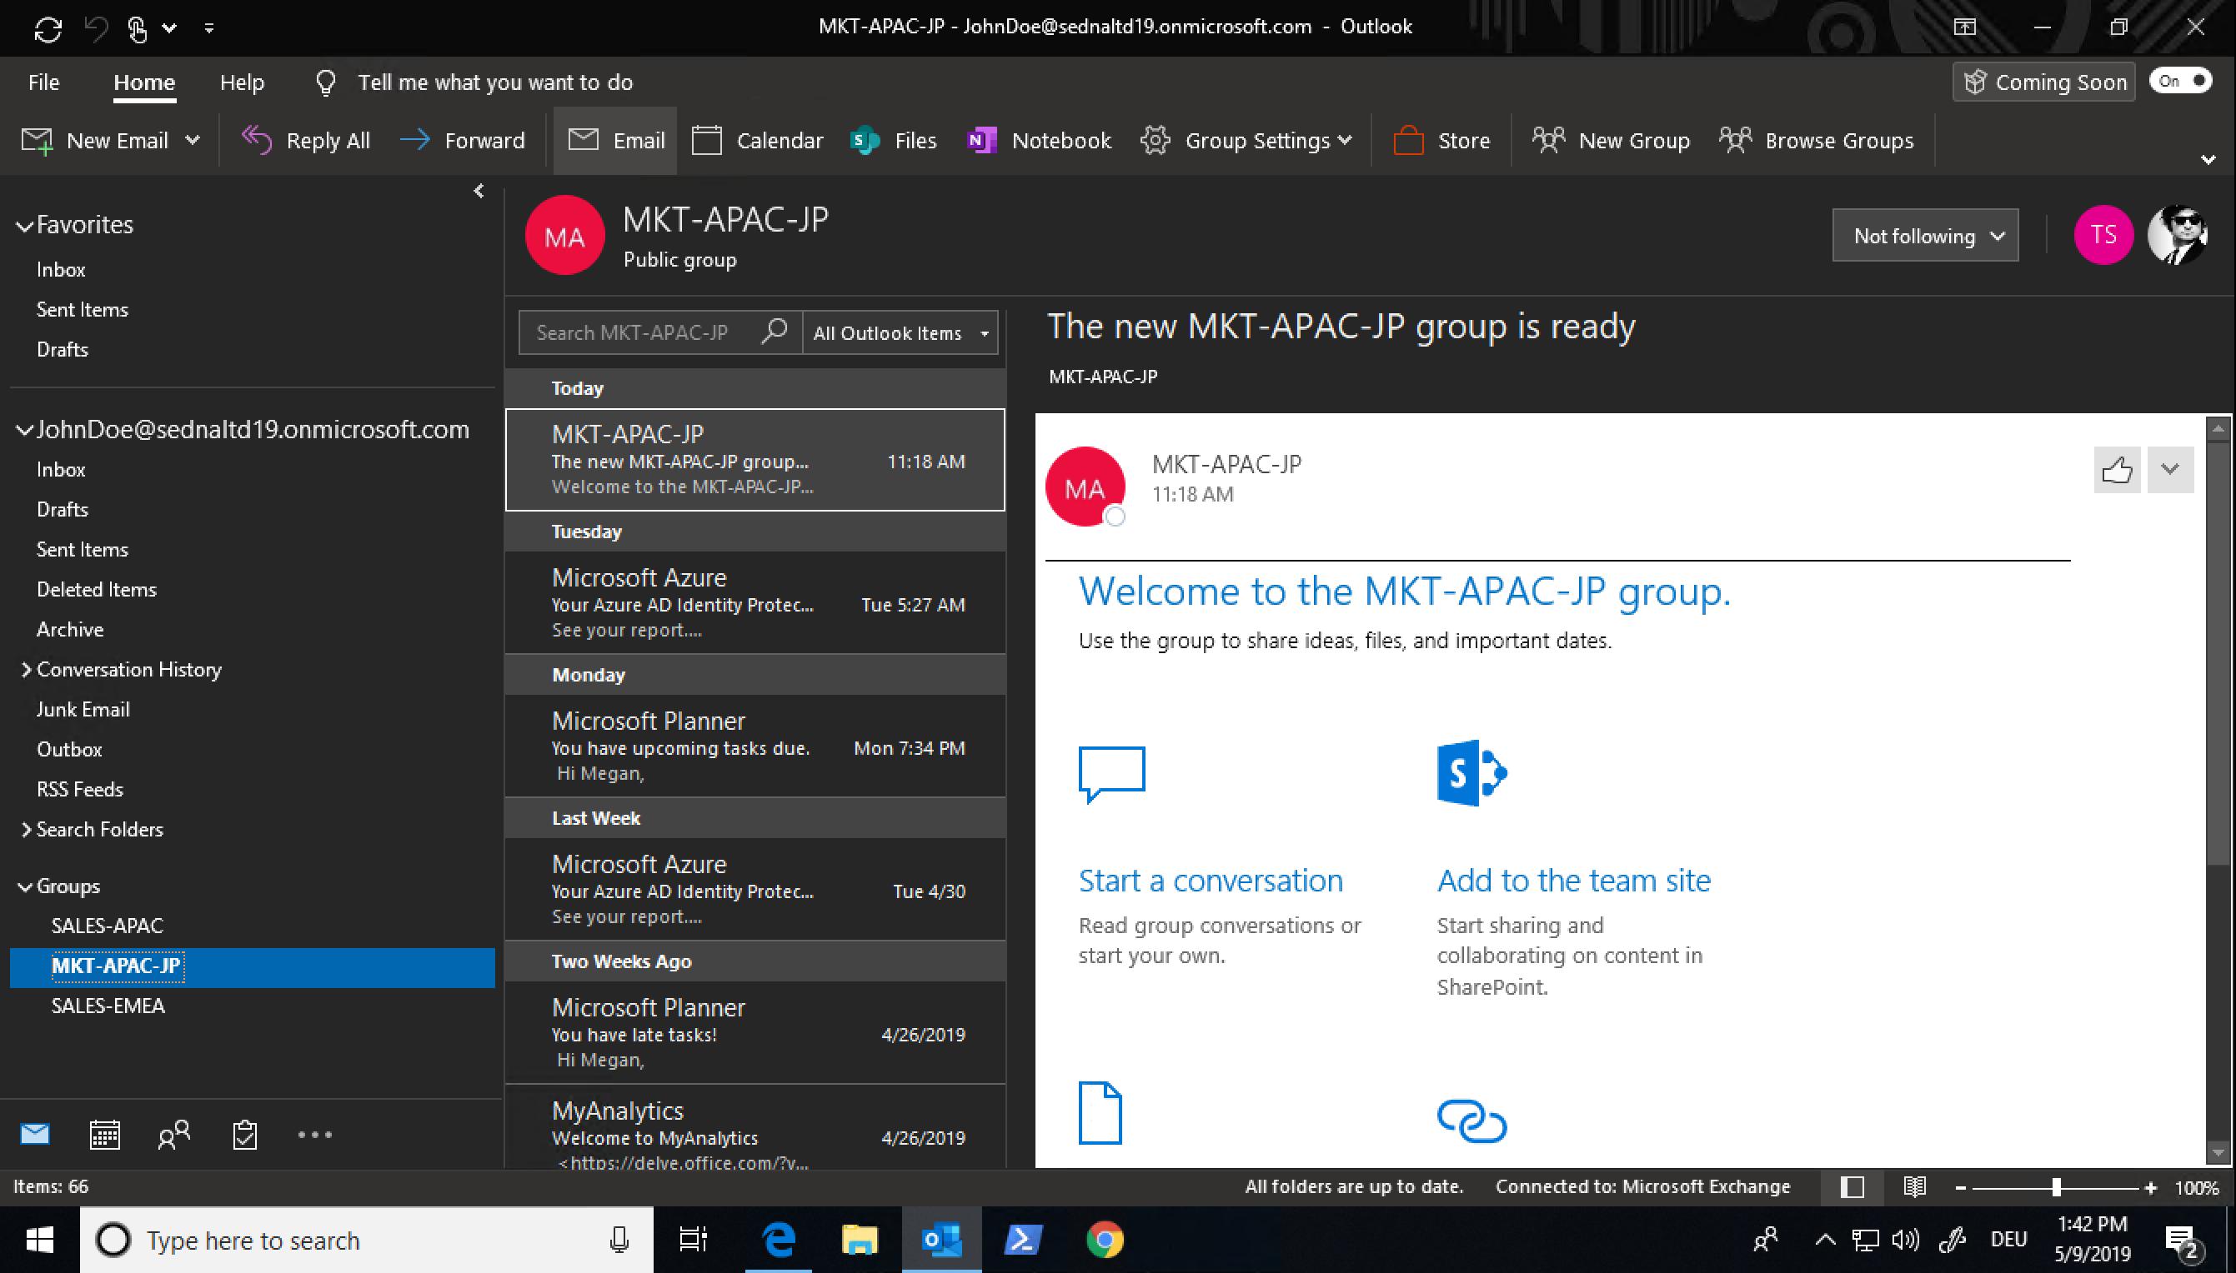

Slide 26
Batch Migration to Office 365 Groups | Ressources
Modern Public Folders
From Exchange Server 2016/2019 to Office 365 Groups
From Exchange Online to Office 365 Groups
From Exchange Server 2013 to Office 365 Groups
Legacy Public Folders
From Exchange Server 2010 to Office 365 Groups

Slide 27
Conclusion

Slide 28
Conclusion
Be prepared for the End-Of-Support for Exchange Server 2010
Know the limits of modern public folders
Reduce the number of legacy public folders to migrate
Remove orphaned information from Active Directory
Migrate to on-premises or online modern public folders
Move to modern technologies → Office 365 Groups / Microsoft Teams
Know the limits of Office 365 Groups

Slide 29
The Future of Public Folders
No plans to decommission modern public folders
Migrate public folders to Microsoft Teams
Review requirements for modern public folder usage and move content to other technologies

Slide 30


Slide 32

Email: Thomas.Stensitzki@Granikos.eu Blog: http://blog.Stensitzki.de Twitter: @stensitzki

Slide 33
Resources
Migration to Modern Public Folders – Notes from the Field
Migration von Legacy Public Foldern zu Exchange Online
Rename and Trim Legacy Public Folders for Modern Public Folder Migration
Public Folder Migration Action Plan
Public Folder Replication Report
PowerShell Community Scripts

